Slide 1
StatefulSet
Kubernetes

Slide 2
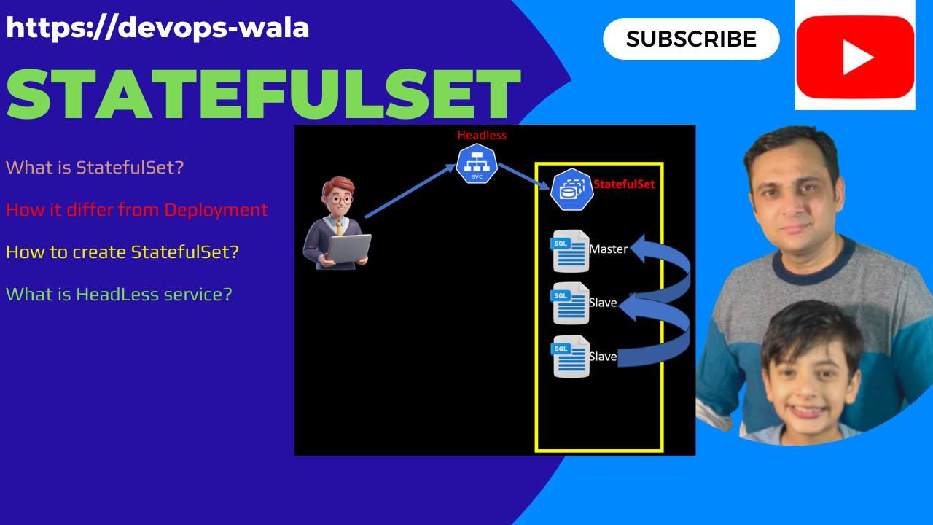

Slide 3
Agenda
Introduction
Different then Deployment
Components
What is a StatefulSet?
Key Features
Headless Service
Difference between StatefulSet and Deployment?
When to use StatefulSet (use case)?
Pod Template
Volume Claim Templates
Headless Services
Storage Classes
Labels and Selectors
Implementation
Scaling Operations
Updates and Upgrades
Basic StatefulSet Configuration
Advance configuration
Manual Scaling
Scale Down
Automatic Scaling
Blue/Green Strategy
canary
rolling

Slide 4
01 NOW WE WILL TALK ABOUT
What is a StatefulSet?

Slide 5
What is a StatefulSet?
A StatefulSet is a Kubernetes resource designed to manage stateful applications.
A stateful application is one that maintains the state of its interactions over time. This means that the application keeps track of user sessions, data, and other contextual information between requests.
example:
Online shopping platforms that remember items in a user's cart.
Social media applications that keep track of user preferences and interactions.
Notes:
https://kubernetes.io/docs/concepts/workloads/controllers/statefulset/

Slide 6



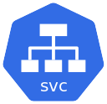

stateless
Maintain state
StatefulSet

Slide 7
What is a StatefulSet?
A StatefulSet is a Kubernetes resource designed to manage stateful applications.
Unlike a Deployment, which is suitable for stateless applications, a StatefulSet provides guarantees about the ordering and uniqueness of pods.
A StatefulSet runs a group of Pods and maintains a sticky identity for each of those Pods.
[root@master1 ~]# kubectl get statefulsets
NAME READY AGE
nginx 3/3 114s
[root@master1 ~]# kubectl get pods
NAME READY STATUS RESTARTS AGE
nginx-0 1/1 Running 0 119s
nginx-1 1/1 Running 0 93s
nginx-2 1/1 Running 0 41s
[root@master1 ~]# kubectl delete pod/nginx-0
pod "nginx-0" deleted
[root@master1 ~]# kubectl get pods
NAME READY STATUS RESTARTS AGE
nginx-0 1/1 Running 0 21s
nginx-1 1/1 Running 0 2m6s
nginx-2 1/1 Running 0 74s

Slide 8
What is a StatefulSet?
A StatefulSet is a Kubernetes resource designed to manage stateful applications.
Unlike a Deployment, which is suitable for stateless applications, a StatefulSet provides guarantees about the ordering and uniqueness of pods.
This is crucial for applications that require stable identities, persistent storage, and ordered deployment and scaling.

Slide 9



Deployment
ReplicaSet 1

Slide 10

Deployment
statefulSet
ReplicaSet 1

Slide 11
What is a StatefulSet?
A StatefulSet is a Kubernetes resource designed to manage stateful applications.
Unlike a Deployment, which is suitable for stateless applications, a StatefulSet provides guarantees about the ordering and uniqueness of pods.
This is crucial for applications that require stable identities, persistent storage, and ordered deployment and scaling.
Key Features of StatefulSets
Stable Network Identity: Each pod in a StatefulSet has a unique, stable hostname that persists across rescheduling.
[root@master1 ~]# kubectl get statefulsets
NAME READY AGE
nginx 3/3 114s
[root@master1 ~]# kubectl get pods
NAME READY STATUS RESTARTS AGE
nginx-0 1/1 Running 0 119s
nginx-1 1/1 Running 0 93s
nginx-2 1/1 Running 0 41s
[root@master1 ~]# kubectl delete pod/nginx-0
pod "nginx-0" deleted
[root@master1 ~]# kubectl get pods
NAME READY STATUS RESTARTS AGE
nginx-0 1/1 Running 0 21s
nginx-1 1/1 Running 0 2m6s
nginx-2 1/1 Running 0 74s

Slide 12
What is a StatefulSet?
A StatefulSet is a Kubernetes resource designed to manage stateful applications.
Unlike a Deployment, which is suitable for stateless applications, a StatefulSet provides guarantees about the ordering and uniqueness of pods.
This is crucial for applications that require stable identities, persistent storage, and ordered deployment and scaling.
Key Features of StatefulSets
Stable Network Identity: Each pod in a StatefulSet has a unique, stable hostname that persists across rescheduling.
Stable Storage: StatefulSets can be associated with PersistentVolumeClaims (PVCs) that ensure data is retained even if the pod is deleted or rescheduled.
Ordered Deployment and Scaling: Pods are created, updated, and deleted in a specific order, ensuring that the application can maintain its state.
Pods are updated one by one in reverse order
Pod-2
v1
Pod-2
v1
Pod-2
v2
Pod-2
v2
Pod-2
v2
Pod-1
v1
Pod-1
v1
Pod-1
v1
Pod-1
v2
Pod-1
v2
Pod-0
v1
Pod-0
v1
Pod-0
v1
Pod-0
v1
Pod-0
v2

Slide 13
What is a StatefulSet?
A StatefulSet is a Kubernetes resource designed to manage stateful applications.
Unlike a Deployment, which is suitable for stateless applications, a StatefulSet provides guarantees about the ordering and uniqueness of pods.
This is crucial for applications that require stable identities, persistent storage, and ordered deployment and scaling.
Key Features of StatefulSets
Stable Network Identity: Each pod in a StatefulSet has a unique, stable hostname that persists across rescheduling.
Stable Storage: StatefulSets can be associated with PersistentVolumeClaims (PVCs) that ensure data is retained even if the pod is deleted or rescheduled.
Ordered Deployment and Scaling: Pods are created, updated, and deleted in a specific order, ensuring that the application can maintain its state.
Graceful Termination: Pods are terminated in reverse order, allowing for a controlled shutdown process.

Slide 14
02 NOW WE WILL TALK ABOUT
Different then Deployment

Slide 15
Use Cases for StatefulSets
Databases: Such as MySQL, PostgreSQL, or Cassandra, where data consistency and identity are crucial.
Distributed Systems: Like Kafka or Zookeeper, where nodes need to maintain their state and identity.
Applications with Persistent Data: Any application that requires persistent storage and stable network identities.

Slide 16

Headless
StatefulSet
Master
Slave
Slave

Slide 17
Headless
Master
Slave
Slave

Slide 18
Feature
StatefulSet
Deployment
Use Case
Manages stateful applications (databases)
Manages stateless applications (web servers)
Pod Identity
Each pod has a unique, stable identity (hostname)
Pods are interchangeable and do not have stable identities (hostname)
Storage
Supports persistent storage with stable PVCs
Different PVs are used for each pod
Typically uses ephemeral storage; can use PVCs Same PV is used for all PODs
Ordering
Guarantees ordered deployment, scaling, and termination
No guaranteed order for deployment or scaling
(pods get deleted /created randomly)
Network Identity
Stable network identity (e.g., mysql-0, mysql-1)
No stable network identity; pods are accessed via a service
Scaling
Pods are scaled in order (e.g., 0, 1, 2)
Pods can be scaled up or down without order
Pods created parallelly.
Use of Headless Services
Often used with headless services for direct pod access
Typically uses standard services for load balancing

Slide 19
02 NOW WE WILL TALK ABOUT
Component of StatefulSet

Slide 20
apiVersion: apps/v1
kind: StatefulSet
metadata:
name: mysql
spec:
serviceName: mysql
replicas: 3
selector:
matchLabels:
app: mysql
template:
metadata:
labels:
app: mysql
spec:
containers:
- name: mysql
image: mysql:5.7
Simple StatefulSet config

Slide 21
apiVersion: apps/v1
kind: StatefulSet
metadata:
name: my-statefulset
spec:
serviceName: "my-service"
replicas: 2
selector:
matchLabels:
app: mysql
template:
metadata:
labels:
app: mysql
spec:
containers:
- name: mysql
image: mysql:5.7
ports:
- containerPort: 80
volumeMounts:
- name: my-storage
mountPath: /data
volumeClaimTemplates:
- metadata:
name: my-storage
spec:
accessModes: [ "ReadWriteOnce" ]
resources:
requests:
storage: 1Gi
apiVersion: v1
kind: Service
metadata:
name: my-service
spec:
clusterIP: None # Headless service
selector:
app: mysql
ports:
- port: 80
targetPort: 80
spec:
containers:
- name: static-nfs-container1
image: nginx
volumeMounts:
- name: static-nfs-volume
mountPath: "/var/www/html"
volumes:
- name: static-nfs-volume
persistentVolumeClaim:
claimName: task-pv-claim

Slide 22
02 NOW WE WILL TALK ABOUT
Updates and Upgrades

Slide 23
Blue-Green Deployment
Master Node
Worker Node 1
Worker Node 2
192.168.1.32
192.168.1.33

Slide 24
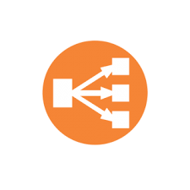
Workernode 1: 192.168.1.32
Workernode 2: 192.168.1.33
www.example.com: 192.168.1.31
Kubernetes cluster

Slide 25

Workernode 1: 192.168.1.32
Workernode 2: 192.168.1.33
Kubernetes cluster 1
www.example.com: 192.168.1.31

Slide 26

Workernode 1: 192.168.1.32
Workernode 2: 192.168.1.33
Cluster2, node1 ip
Kubernetes cluster 1
Cluster2, node2 ip
www.example.com: 192.168.1.31
Kubernetes cluster 2

Slide 27
Workernode 1: 192.168.1.32
Workernode 2: 192.168.1.33
Kubernetes cluster 1
Kubernetes cluster 2

